Slide 1
Accurate Accounting Solutions
Rendering cost-value advantage

Slide 2
INTRODUCTION
Welcome to IOA Consultant
This is a professional business consulting and staffing firm with specialties In finance, accounting, training courses of CMA & CPA, Audit also. We consider any engagement the first step in developing a long term relationship with our clients. IOA will give proper attention to understand your desired needs and outcomes as well as the drivers of your business. With a strong leadership team, experienced advisors and success stories to back our proven results. IOA will become a valuable business partner with your organization.

Slide 3
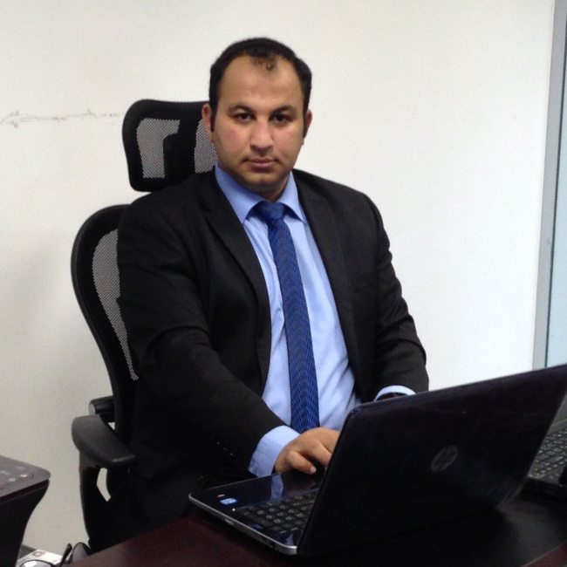
CEO Message
In this age of cut threat competition, it is imperative for top and middle level Managers to update themselves with the statistics and current affairs of the company which are important for the policy formulation. Our services also facilitate our clients in assessing their financial positions on quarterly / half yearly or annual basis. We provide accurate and timely services, full range of accounting, book keeping, quarterly updates and financial statement preparation services.
As an independent corporation, we are familiar with the accounting needs and desires of high growth, fast paced companies. We apply a significant amount of our time to learn client business, to understand how precisely we can be of aid to them. This includes the writing up of accounts and the preparation of financial statements. It includes a wide area ranging from simple Book keeping to complex financial analysis.

Slide 4
CURRENTLY WE ARE OFFERING
Accounting
Handle Accounting from Bookkeeping till Financial Reports preparation.
Auditing
Internal Audit, Internal Control
External Audit
TAX Consulting
VAT & Excise Tax Consultancy Services

Slide 5
ACCOUNTING SERVICES
Account & Cost Management
Financial Statement & External Auditor
Internal Audit & Control
Strategic Finance Plan
Business Valuation
Record Maintenance
Recruitment for Accounts Department
Reports for Internal Management
Accounting Software
Training (Financial Module, Cost Management & Budgeting etc.)

Slide 6
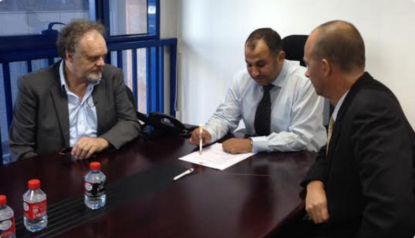
We care for our work

Slide 7
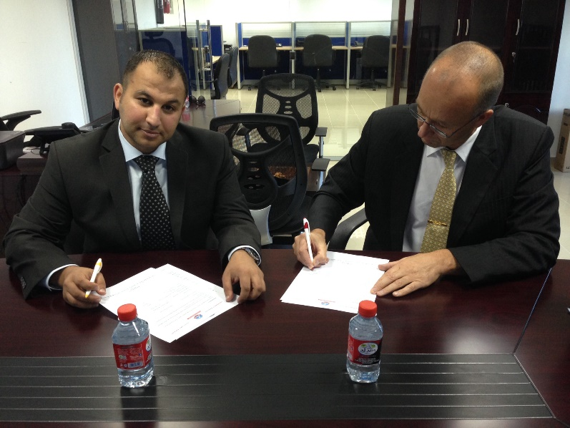
We care for our work

Slide 8
Contact us
E-mail : dr.sherif@ioa.ae
Tel: 02-6670795
Cell: 055-1700141
Website: www.ioa.ae

Slide 9
thanks
www.ioa.ae

